Slide 1

What’s coming with ABP 7.0?
Halil İbrahim Kalkan

Slide 2

Overall
Upgrading to .NET 7.0
Dapr integration
Integration services
Dynamic features & permissions
External localization system

Slide 3
Dapr Integration
Service invocation with C# API Client Proxies integration
Publish & Subscribe with Distributed Event Bus integration
Distributed Lock
Already documented: https://github.com/abpframework/abp/blob/dev/docs/en/Dapr/Index.md

Slide 4
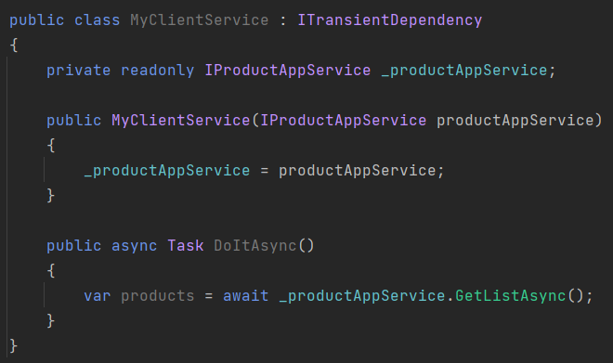
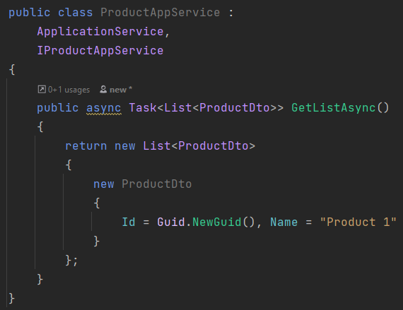
ABP Dynamic C# Client Proxies
.NET Client Application
Server Application
ABP Framework Authentication JSON serialization Exception handling Multi-tenancy
Retry, …. and more

Slide 5
ABP Dynamic C# Client Proxies
.NET Client Application
Server Application
Dapr Sidecar
Dapr Sidecar
ABP Framework Authentication JSON serialization Exception handling Multi-tenancy
Retry, …. and more
Dapr Service discovery Tracing / observability Security
Retry, …. and more

Slide 6

Distributed Event Bus
Microservice A
Microservice B
event
event
ABP Event Bus
Message Broker
(RabbitMQ, Kafka, etc)
ABP Event Bus
application data
application data
re-connect
re-try
publish/subscribe
background workers
auto-events
distributed locking
outbox/inbox
outbox/inbox

Slide 7
Distributed Event Bus
Microservice A
Microservice B
event
event
Dapr Sidecar
Message Broker
(RabbitMQ, Kafka, etc)
Dapr Sidecar
application data
ABP Event Bus
ABP Event Bus
application data
outbox/inbox
outbox/inbox

Slide 8
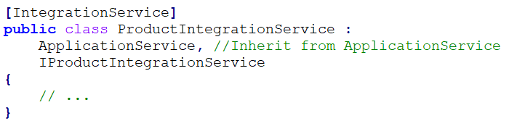
Integration services
Introduced the [IntegrationService] attribute
Default HTTP API URL prefix: /integration-api/… instead of /api/…
Audit logging is disabled by default, but can be enabled
Unit of work, Validation, etc. works as expected

Slide 9
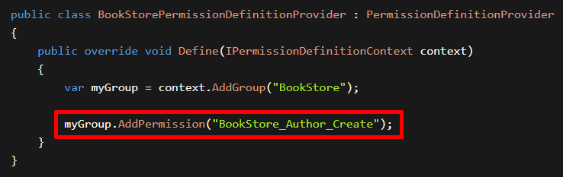
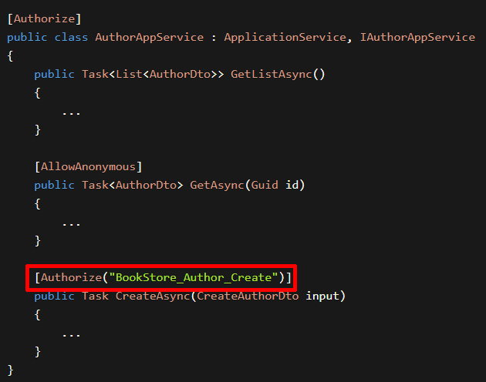
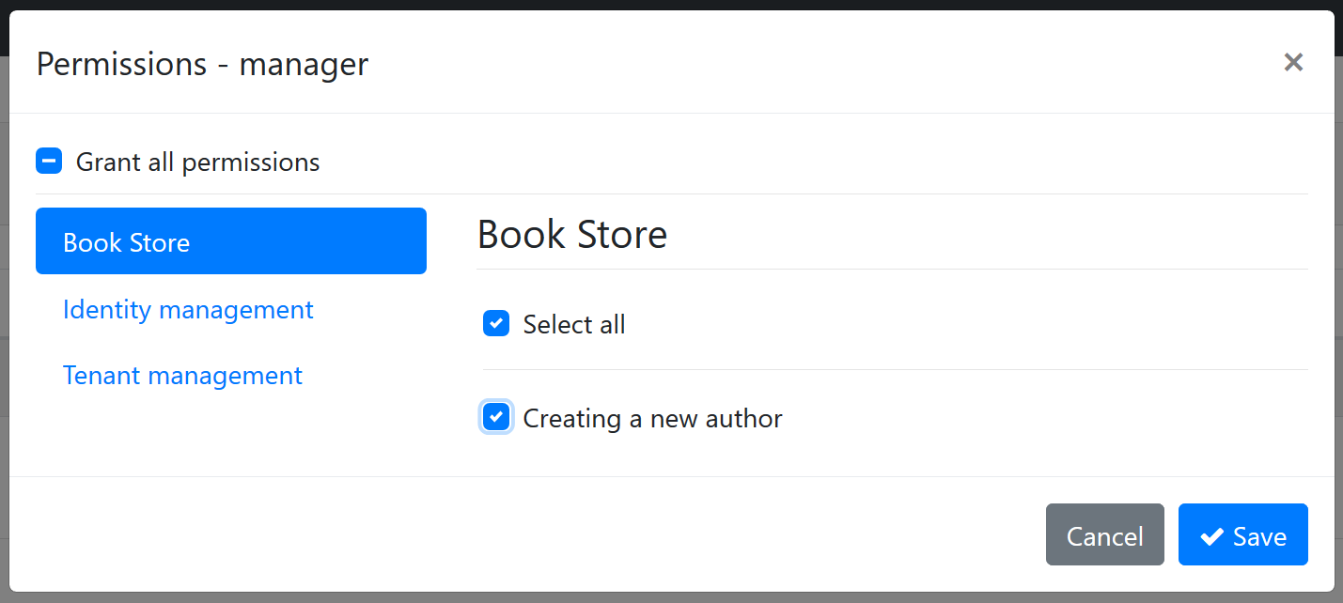
Dynamic Permissions & Features
(1) Define Permissions
(2) Check Permissions
(3) Grant Permissions

Slide 10
Dynamic Permissions & Features
Microservice 1
Permission A, B
Permission Management Database
Microservice 2
Permission C, D, E
The Permission Management UI
Permission Management Microservice
Database Tables AbpPermissionGrants
AbpPermissionGroups AbpPermissions

Slide 11
Topic title
Content

Slide 12
Topic title
Content

Slide 13
Topic title
Content

